Slide 1


Hospitality: CTI Milestone 1
Trenton Card
Charles Runyon

Slide 2
Industry Background
Key Services of the Hospitality Sector
Lodging – Hotels, Motels, Bed and Breakfast; Market segments include leisure, business, groups, and long-stay; Marriot International, Hilton
Travel and Tourism – Transportation; Air, Boat, Cab, Car; TUI Group, Expedia
Food and Beverage (F&B) – Meals, snacks, beverages for immediate consumption; Ranges from quick eats to restaurants;
Recreation – Rest, Relaxation, and Enjoyment; Spa, Entertainment, Sports; MGM Resorts International
What Are The 4 Segments Of The Hospitality Industry | By Peter Novak – Hospitality Net
Notes:
https://www.statista.com/study/54402/top-100-companies-travel-and-tourism/

Slide 3
Industry Background
Key Sectors of Growth
Hospitality sectors are conglomerate of other industry subsectors
Lodging – Worldwide forecast is $1.22tr; $1.21tr in 2019 (statista.com)
Travel and Tourism – Overall global size $9.25tr (statista.com)
Food and Beverage (F&B) – Forecasted $2.13tr in 2021; Expected 5% CAGR growth till at least 2025 (statista.com)
Recreation – Multi-Trillion-dollar industry with expected growth after COVID
Notes:
Hotel and resort industry market size worldwide 2021 | Statista
Travel and tourism industry in the U.S. - statistics & facts | Statista
Food & Beverages - United States | Statista Market Forecast

Slide 4
Industry Background
Key Growth Drivers
Covid reopening
New Markets and Travelers; i.e., Asian Pacific didn’t travel as much for leisure as they do now
Cost of travel and ease of use has drastically improved
Business travel is increasing due to globalization of industries
Modern knowledge works allows for travel and consumers are looking for experiential travels
Notes:
Top 4 hospitality and tourism industry drivers (ehl.edu)

Slide 5
Relevant Trends
Key Technologies and Exploits
Server/Client Systems – Traditional Information Systems; exploits include MS server vulnerabilities and exploits
Network Devices – Used for Telcom (VOIP), Streaming, On-demand and Broadcast usage; Hijacking and traffic sniffing could be used for Social Engineering
Wireless internet offering in room and/or on grounds; Man in Middle exploits
Email/SMS (Messaging) – Delivery of Malware or Social Engineering
Mobile Technologies – Mobile Apps used for Digital Entry or room charges. Can be used to get services on someone else’s account; stolen credentials

Slide 6
Relevant Trends
Top Exploits
Phishing and Social Engineering
Ransomware
Distributed denial-of-service (DDoS)
Data Exfiltration

Slide 7
Relevant Trends
Targets and Bad Actors
Ransomware – on Building Automation Servers; This exploit is usually acted upon by foreign Black Hats who are trying to hold critical systems ransom for money. OT is usually the most disruptive to the company without disruption to the customers. It allows for the company to contemplate payment vs. restoration costs
Social Engineering – This is used to get customer data or free services by the companies
Data Exfiltration – Black Hat actors and often Script Kiddies looking for easy targets to exfiltrate critical PII from customer databases

Slide 8
Critical Assets Identification
Physical and Operational Technology – Building Automation and Management System, Building Entry Automation, Network Devices; Most systems support the flow of people and comfort settings within the facilities
Information Systems – Business Systems, Point of Sale, Revenue and Accounting systems, On-site or Cloud Servers; Backbone of the service capability and capacity of Lodging, Travel and Entertainment

Slide 9
Critical Assets Identification Cont.
Reservation and Property Management – Customer and Reservation Management Systems, Facilities Maintenance System (Housekeeping and Trouble Calls); Supports the general operations of rooms and facility upkeep
Supply Chain – Food and Beverage Stocking and Procurement systems; ensures supplies are available or in route for providing services
Customer Data – Customer Relationship and Personal Information; Used for personalization of services.

Slide 10
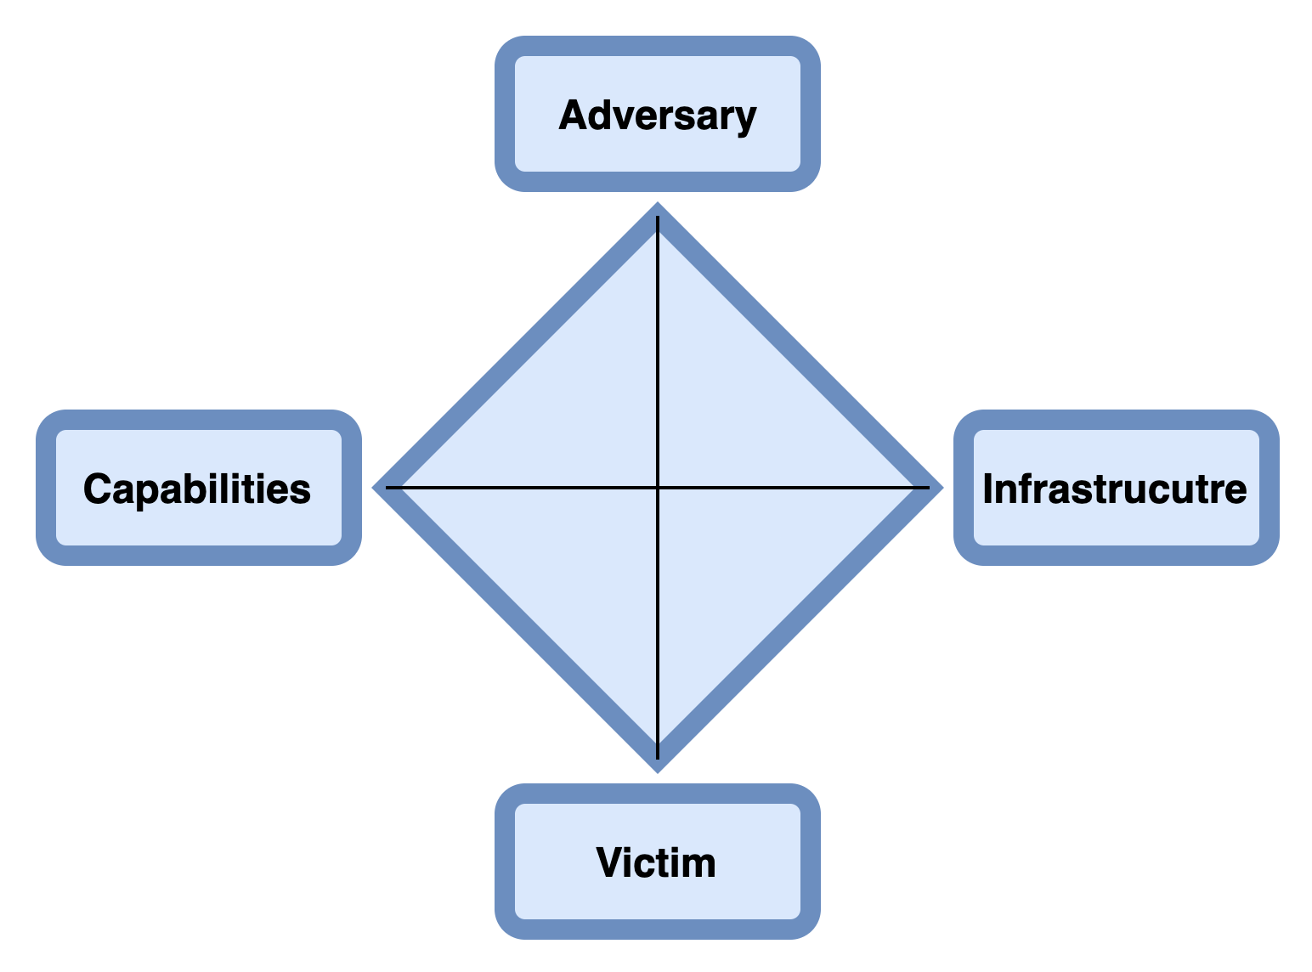
Diamond Model
Operator: Cybercriminals
Events Targeting: Physical and Operational Technology
Man in the middle attack
Spoofing
Adversary workstation
Wireless Access Point
Persona:​ Hilton Hotel
Assets: ​Building Automation System

Slide 11
Diamond Model
Operator: Cybercriminals
Events Targeting: Physical and Operational Technology
Login in credentials
Phishing
Password cracking
Adversary workstation​
VPN Access Point
Persona:​ Hard Rock Hotel
Assets: ​Building Management System

Slide 12
Diamond Model
Operator: Cybercriminals
Customer: Competitor
Events Targeting: Information Systems
DNS exfiltration
Malware
Adversary workstation​
E-mail
Persona:​ Starbucks
Assets: ​Business Systems

Slide 13
Diamond Model
Operator: Cybercriminals
Events Targeting: Information Systems
Ransomware worm
Social engineering
Adversary workstation​​
USB
Persona:​ MGM Resorts
Assets: ​Business systems

Slide 14
Diamond Model
Operator: Cybercriminals
Events Targeting: Reservation and Property Management
Man in the middle attack​
Spoofing​
Adversary workstation​
Persona:​ Marriott Hotel
Assets: Facilities Management System

Slide 15
Diamond Model
Operator: Cybercriminals
Events Targeting: Reservation and Property Management
Adversary workstation​​
E-mail​
Remote access software
Malware
Persona:​ American Cruise Lines
Assets: Customer Management System

Slide 16
Diamond Model
Operator: Cybercriminals
Events Targeting: Supply Chain
Remote access software
Login credentials
Adversary workstation
Middleware/API’s Hosting
Persona:​ Disney World Resort
Assets: ​Facilities Management System

Slide 17
Diamond Model
Operator: Cybercriminals
Events Targeting: Supply Chain
Malware
Ransomware
Adversary workstation​​
E-mail​
Persona:​ US Foods
Assets: ​Procurement systems

Slide 18
Diamond Model
Operator: Cybercriminals
Events Targeting: Customer Data
SQL Injection
DNS exfiltration
Adversary workstation​​
E-mail​
Persona:​ Radisson Hotel Group
Assets: ​PII

Slide 19
Diamond Model
Operator: Cybercriminals​
Customer: Competitor
Events Targeting: Customer Data
Phishing
Social Engineering
Adversary workstation​​
E-mail​
Persona: Marriott International
Assets: PII

Slide 20
Intelligence Buy-in
Threat | Impact | Controls | Frequency and Analysis
Ransomware | Loss of Availability to Systems and/or System Data | Installation of Anti-virus or Endpoint Detection and Response | 6,000% percent increase in Ransomware attacks on Hotels; 20% cost more than $40k excluding remediation and installing preventative controls post event; Basic AV included with Windows License
Phishing | Credentials compromised | Training and Awareness; Technical filters on email | Admin credential loss could be the predecessor to Ransomware, Data Exfiltration or other threats; Often training is nominal in cost <$30 per user per annum; Technical controls can be more costly
Notes:
Ransomware Attacks Targeting Hospitality Industry | Washington Hospitality Association | Our mission is to help our members succeed (wahospitality.org)

Slide 21
Intelligence Buy-in
Threat | Impact | Controls | Cost Analysis
Data Exfiltration | Loss of data | Data Loss Prevention training; Data Loss Prevention tools | 2017 Marriot data breach led to a $2bil loss in stock value over the following weeks from data breach. DLP tools can cost less than $500mil per year for large enterprise, most likely less than $50k per year for smaller enterprises
Distributed denial of service (DDoS) | Loss of availability and use of system | Intrusion Prevention and layered defense techniques; outsource network entry via Cloudflare for instance | Loss of use on a system can vary depending on the time of outage. In hospitality it could mean someone goes to competitor site and a loss of booking revenue; Cloud flare is $20/month per 20 pages. Palo Alto Firewall can cost $1200 a year for permitter DDoS protection
Notes:
Marriott breach: Starwood properties reservation data hacked, exposing up to 500 million Starwood guests' names, phone numbers and passport numbers – Live updates today - CBS News

Slide 22
Group Roles and Signatures
Industry background – 3 slides; Charlie
Relevant Threat Trends – 3 slides; Charlie
Critical Asset Identification – 2 slides; Charlie
Diamond Models – 10 Slides; Trenton
Intelligence Buy-In – 2 slides; Charlie
Group Roles and Signatures – 1 slide; Charlie
CTI Platform Setup (url:https://stillatit11.github.io/card_runyon_cti/ )- Trenton

